Slide 1


Deborah Barndt, Dalilah Earley, &
Ignacio Fite Lopez

Slide 2
What’s the Pin Base App?
The Pin Base application is designed to give families, caregivers, and friends a better and simpler experience when it comes to navigating each other’s location.

Slide 3




Who uses Pin Base?
Parents
Want to track their child’s location
45% of 10-12 year olds are added to mobile service plan
Grandparents/Elderly
69.5 million as of 2014
7.3 million live with their grandchild(ren) as of 2015
1 in 3 die with dementia
Babysitters
Usually between 20-25 years of age
1,216,600 childcare workers as of 2016
Children
73% of teens have a smartphone
Many children younger than 13 are regularly without adult supervision
*User descriptions & facts based on USA population

Slide 4
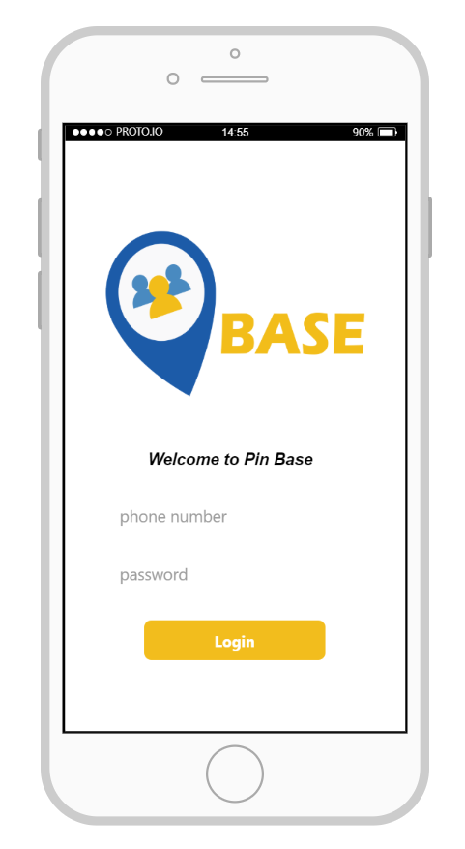
Why should I use Pin Base?
Want to add a family, caregiver or friend?
Create groups to add whomever you want
Want to view someone’s location?
See the past, current and future locations of people in your group
Want to an easily schedule where you or others will be?
Create, edit and delete “checkpoints” of where, when and time you or another individual will be at a particular location.

Slide 5
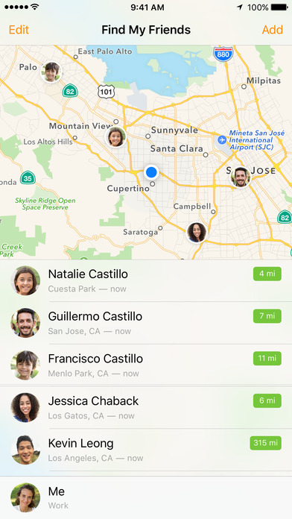
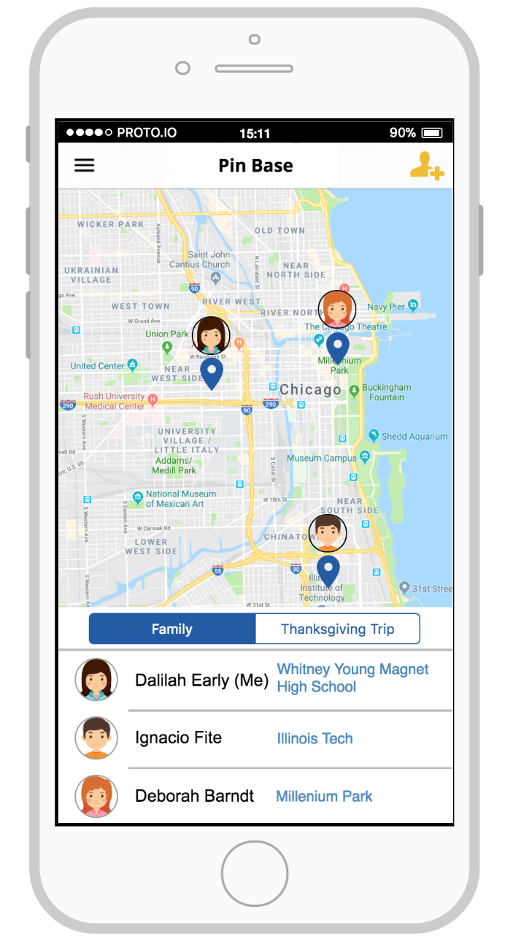
Why not Find My Friends?

Slide 6
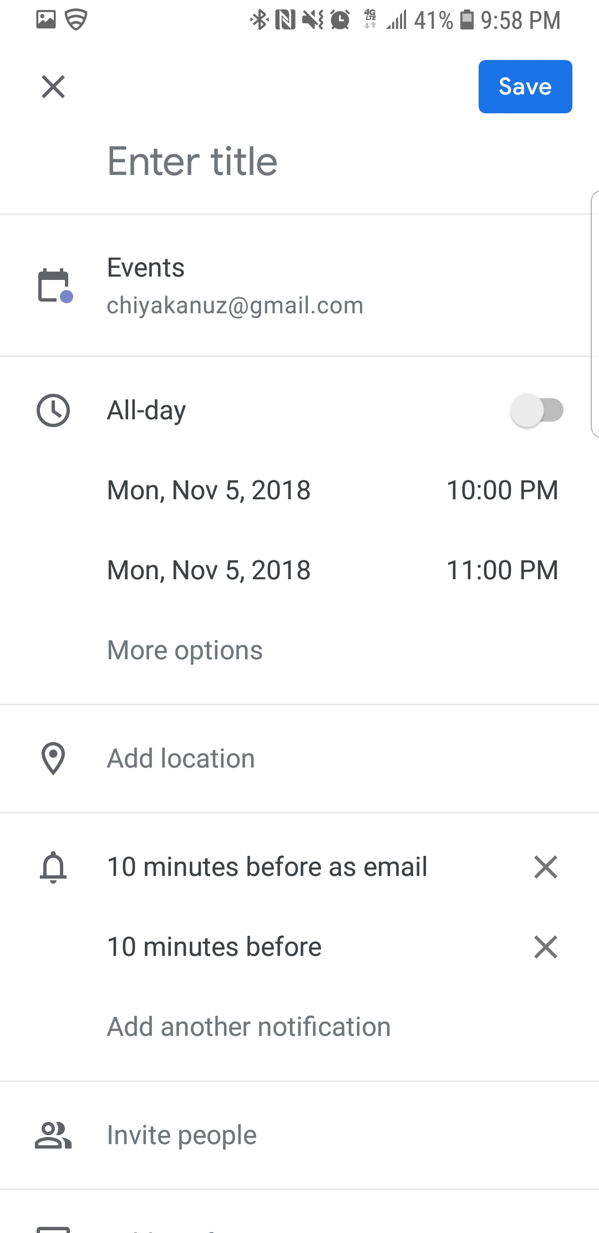
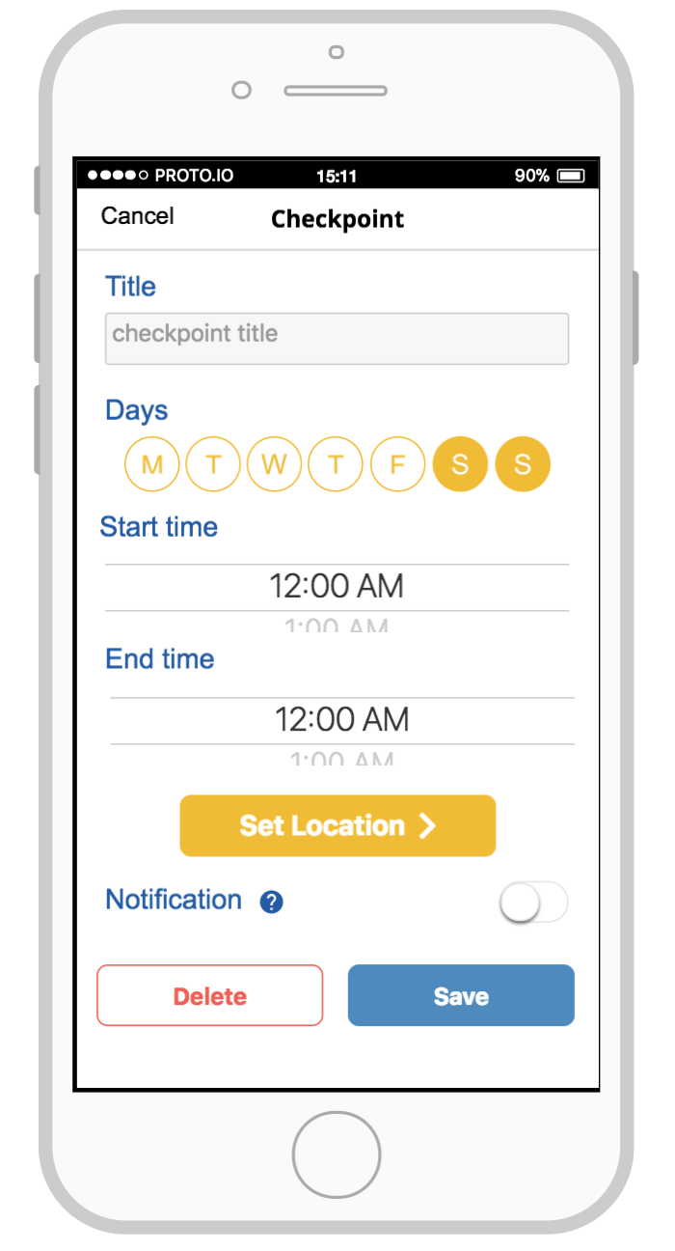
Why not Google Calendar?

Slide 7
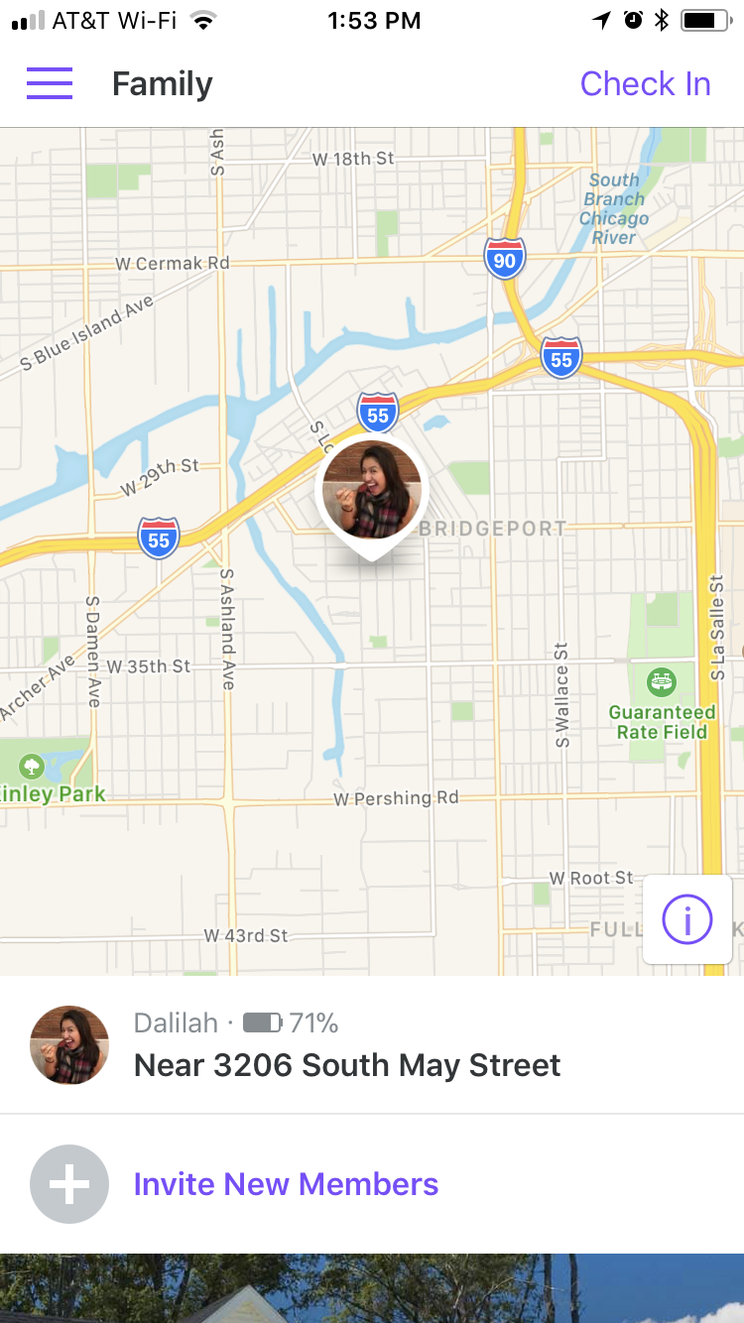
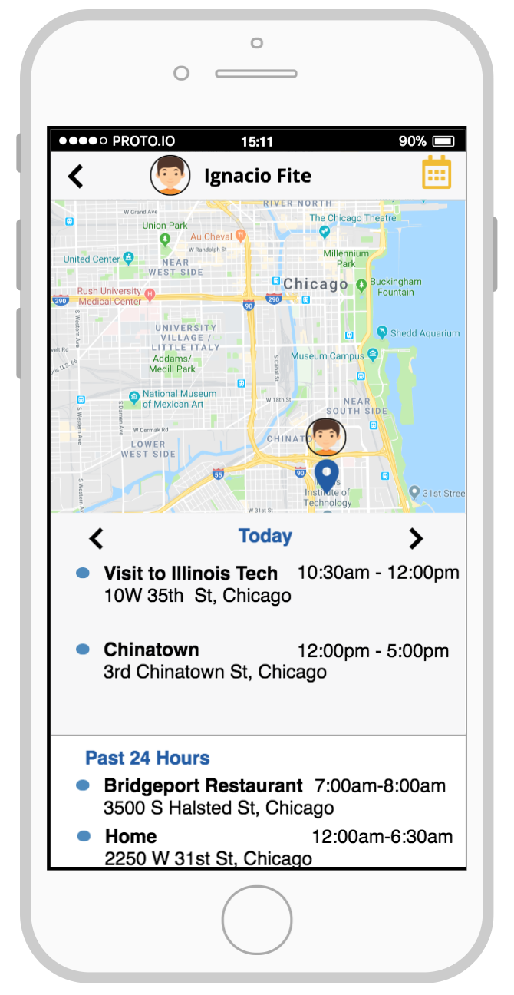
Why not Life360?

Slide 8
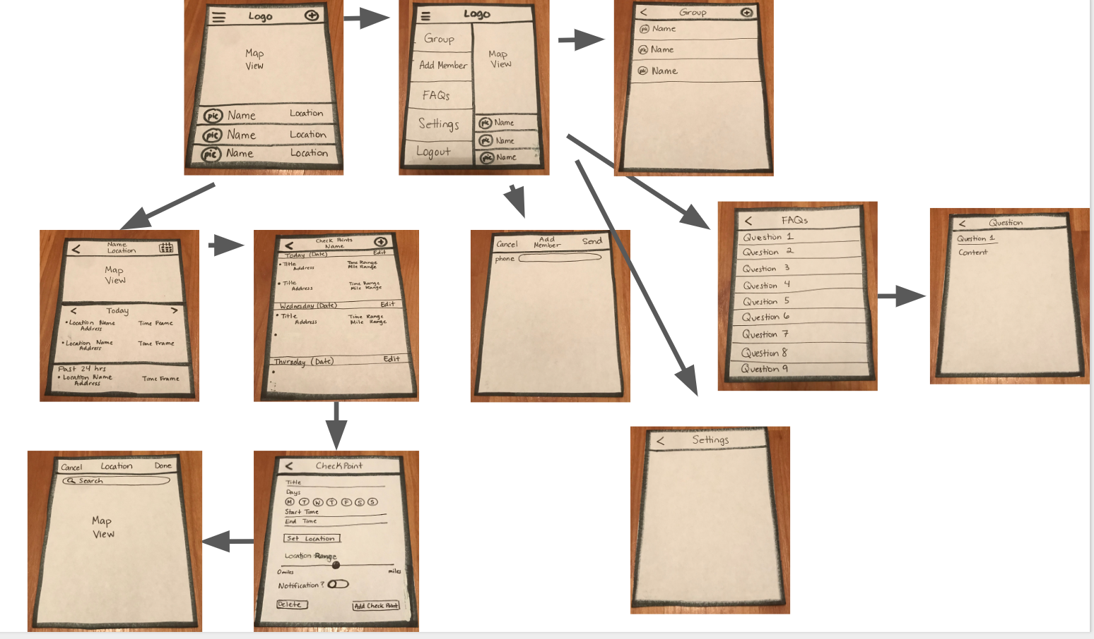
Is Pin Base better than competitors?
Desire to be:
Efficient
Simplistic
Visually friendly for our users ranging from children to elders
Focused on offering our users 3 features the best way possible

Slide 9
Why those colors & font?
Dark blue: #1F5AA6
Light blue: #4B89BF
Cream: #F7F7F8
Yellow: #F2BD1D
Pink: #F25D50
Open Sans font

Slide 10
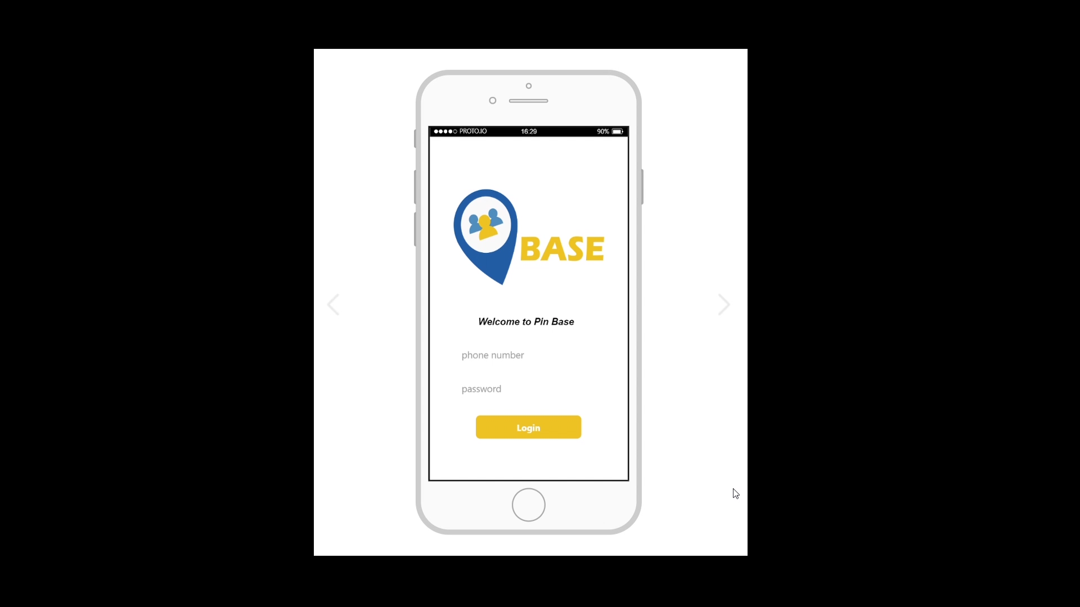
Demo of Pin Base

Slide 11
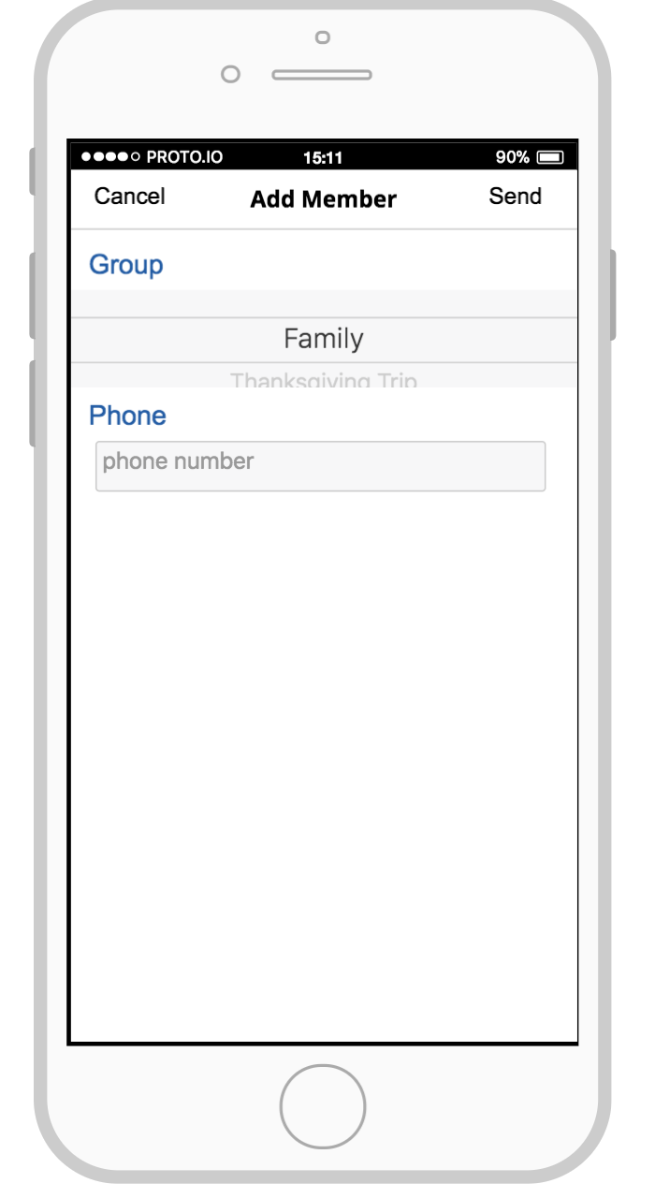
Who uses what Pin Base features?
Adding a member to group
Parents
Caregivers (Babysitters)
Creating checkpoints
Parents
Caregivers (Babysitters or Grandparents)
Older Children/Teens
Viewing someone’s location
Parents
Caregivers (Babysitters or Grandparents)

Slide 12
Does Pin Base pass a HE?
Visibility of system status = Select group to view on home page
Match b/w system & real world = Menu icons & titles
User control & freedom = Creation of groups & checkpoints
Consistency & standards = Use of top horizontal bar, colors, fonts
Error prevention = Cancel and back buttons
Recognition rather than recall = Titles to checkpoints rather than just address
Flexibility & efficiency of use = Creation, editing & deletion of checkpoints
Aesthetic & minimalist design = Past, current & future locations shown
Help users recognize, diagnose, & recover from errors = Set input in text boxes
Help and documentation = Frequently Asked Questions option in menu

Slide 13
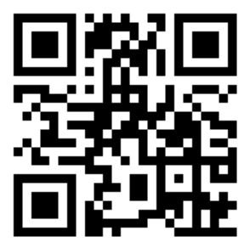
Try Pin Base Now!
https://pr.to/QD1CNP/

